Slide 1
Human Genome Editing
Nicole Henning, Michelle Harrysingh, Sadman Shawraz, Moncerra Esquivel, Nicole Jara, Marilyn Keiderling

Slide 2
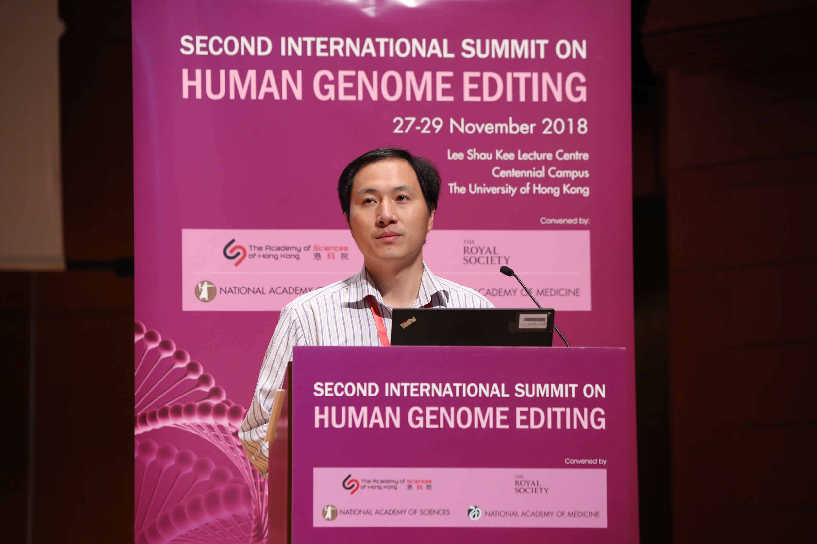
Nov. 2018, Dr. He Jiankui announces birth of world’s first genetically modified infants
He committed ethical and legal violations
Has brought attention to the world of gene editing

Slide 3
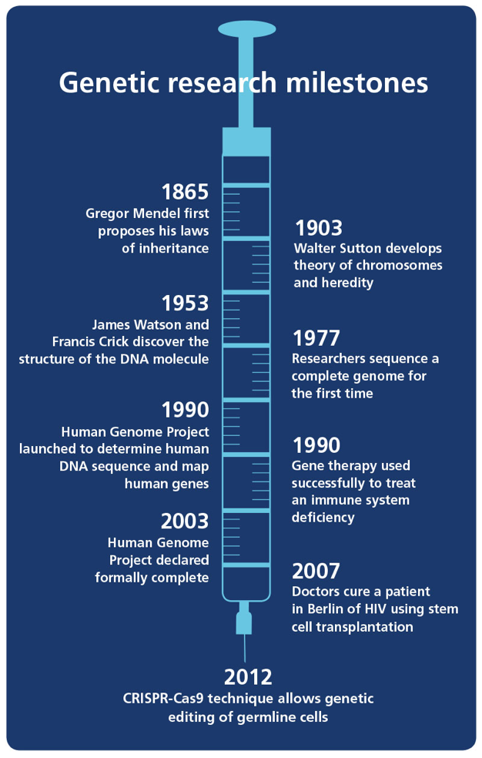
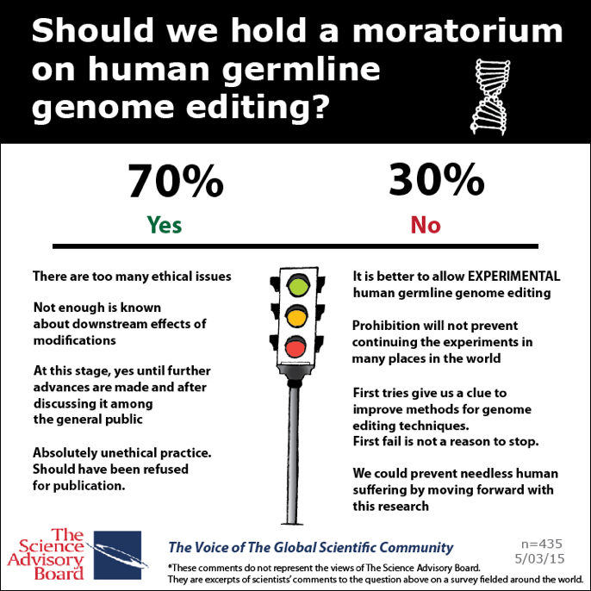

Slide 4
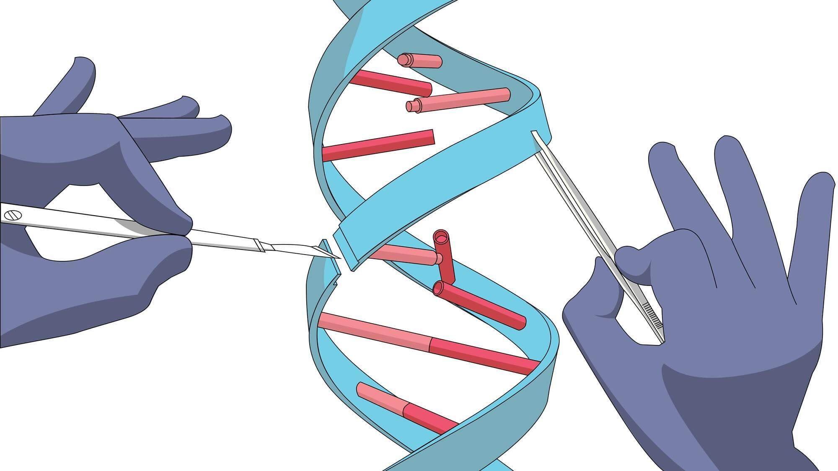
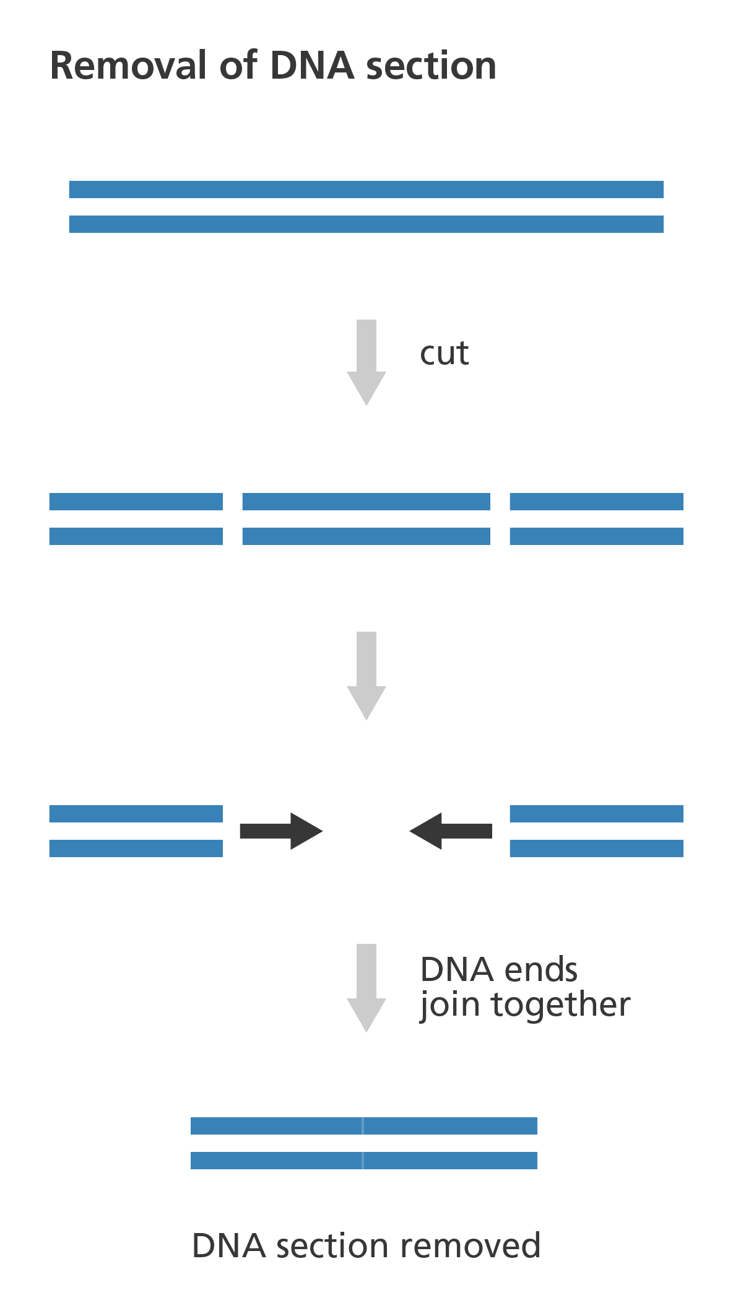
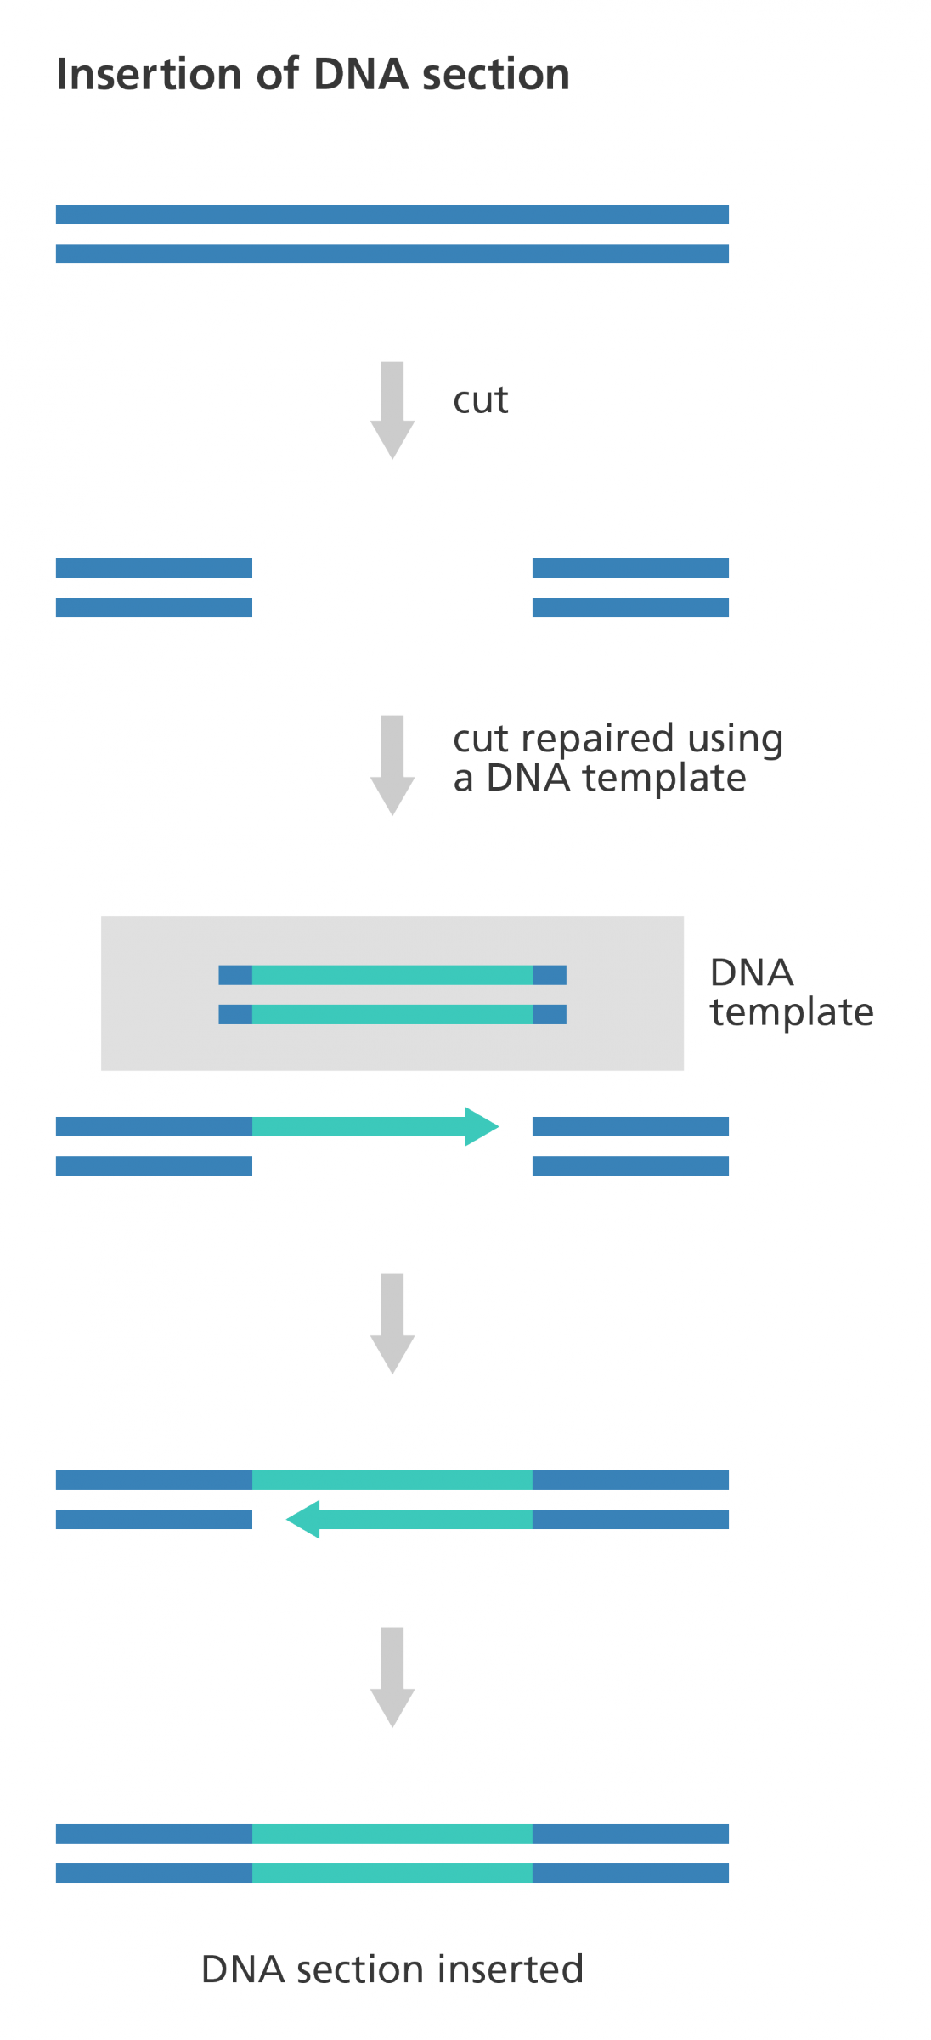
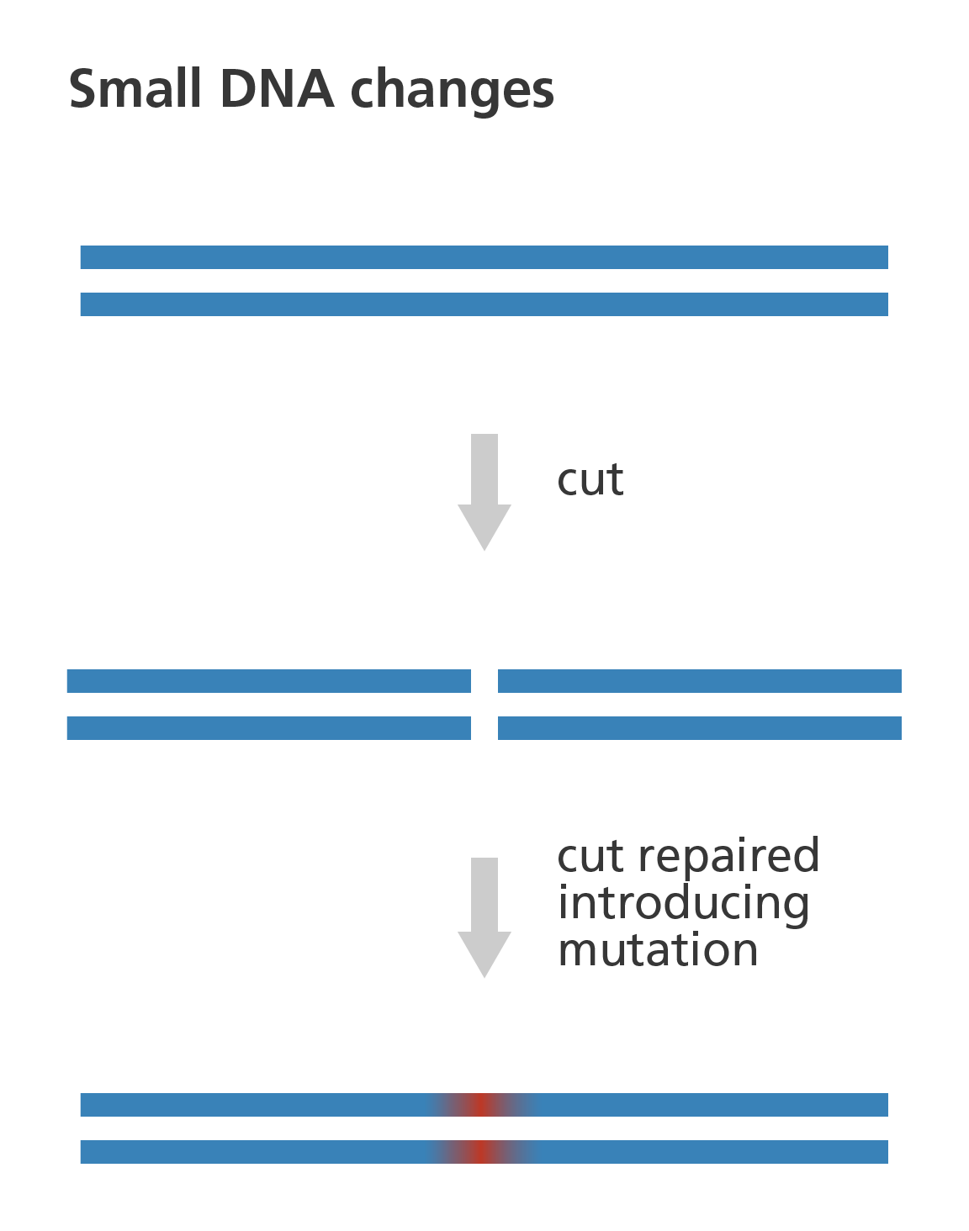
Insertion
Deletion
Modification

Slide 5
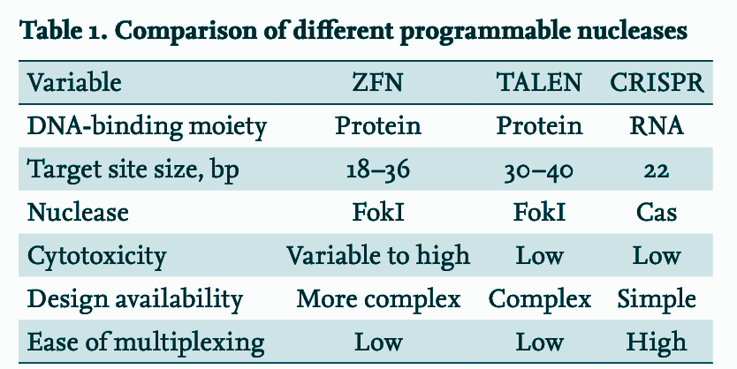

Slide 6
Characteristics of CRISPR
Specificity
modifications at very specific points of the genome
low incidence of undesired secondary effects.
Efficiency
easily produced, with high final percentage of genetically modified sequences in specific location.
Accessibility
relatively simple to apply
only requires a minimum knowledge of genetic manipulation techniques and a modest investment in infrastructure
molecular tools required are accessible in public repositories
Versatility
wide range of variants of the molecular bases used in technology have rapidly emerged
possible to exercise greater control over technique and to obtain greater range of molecular modifications that adapt to needs of researcher

Slide 7
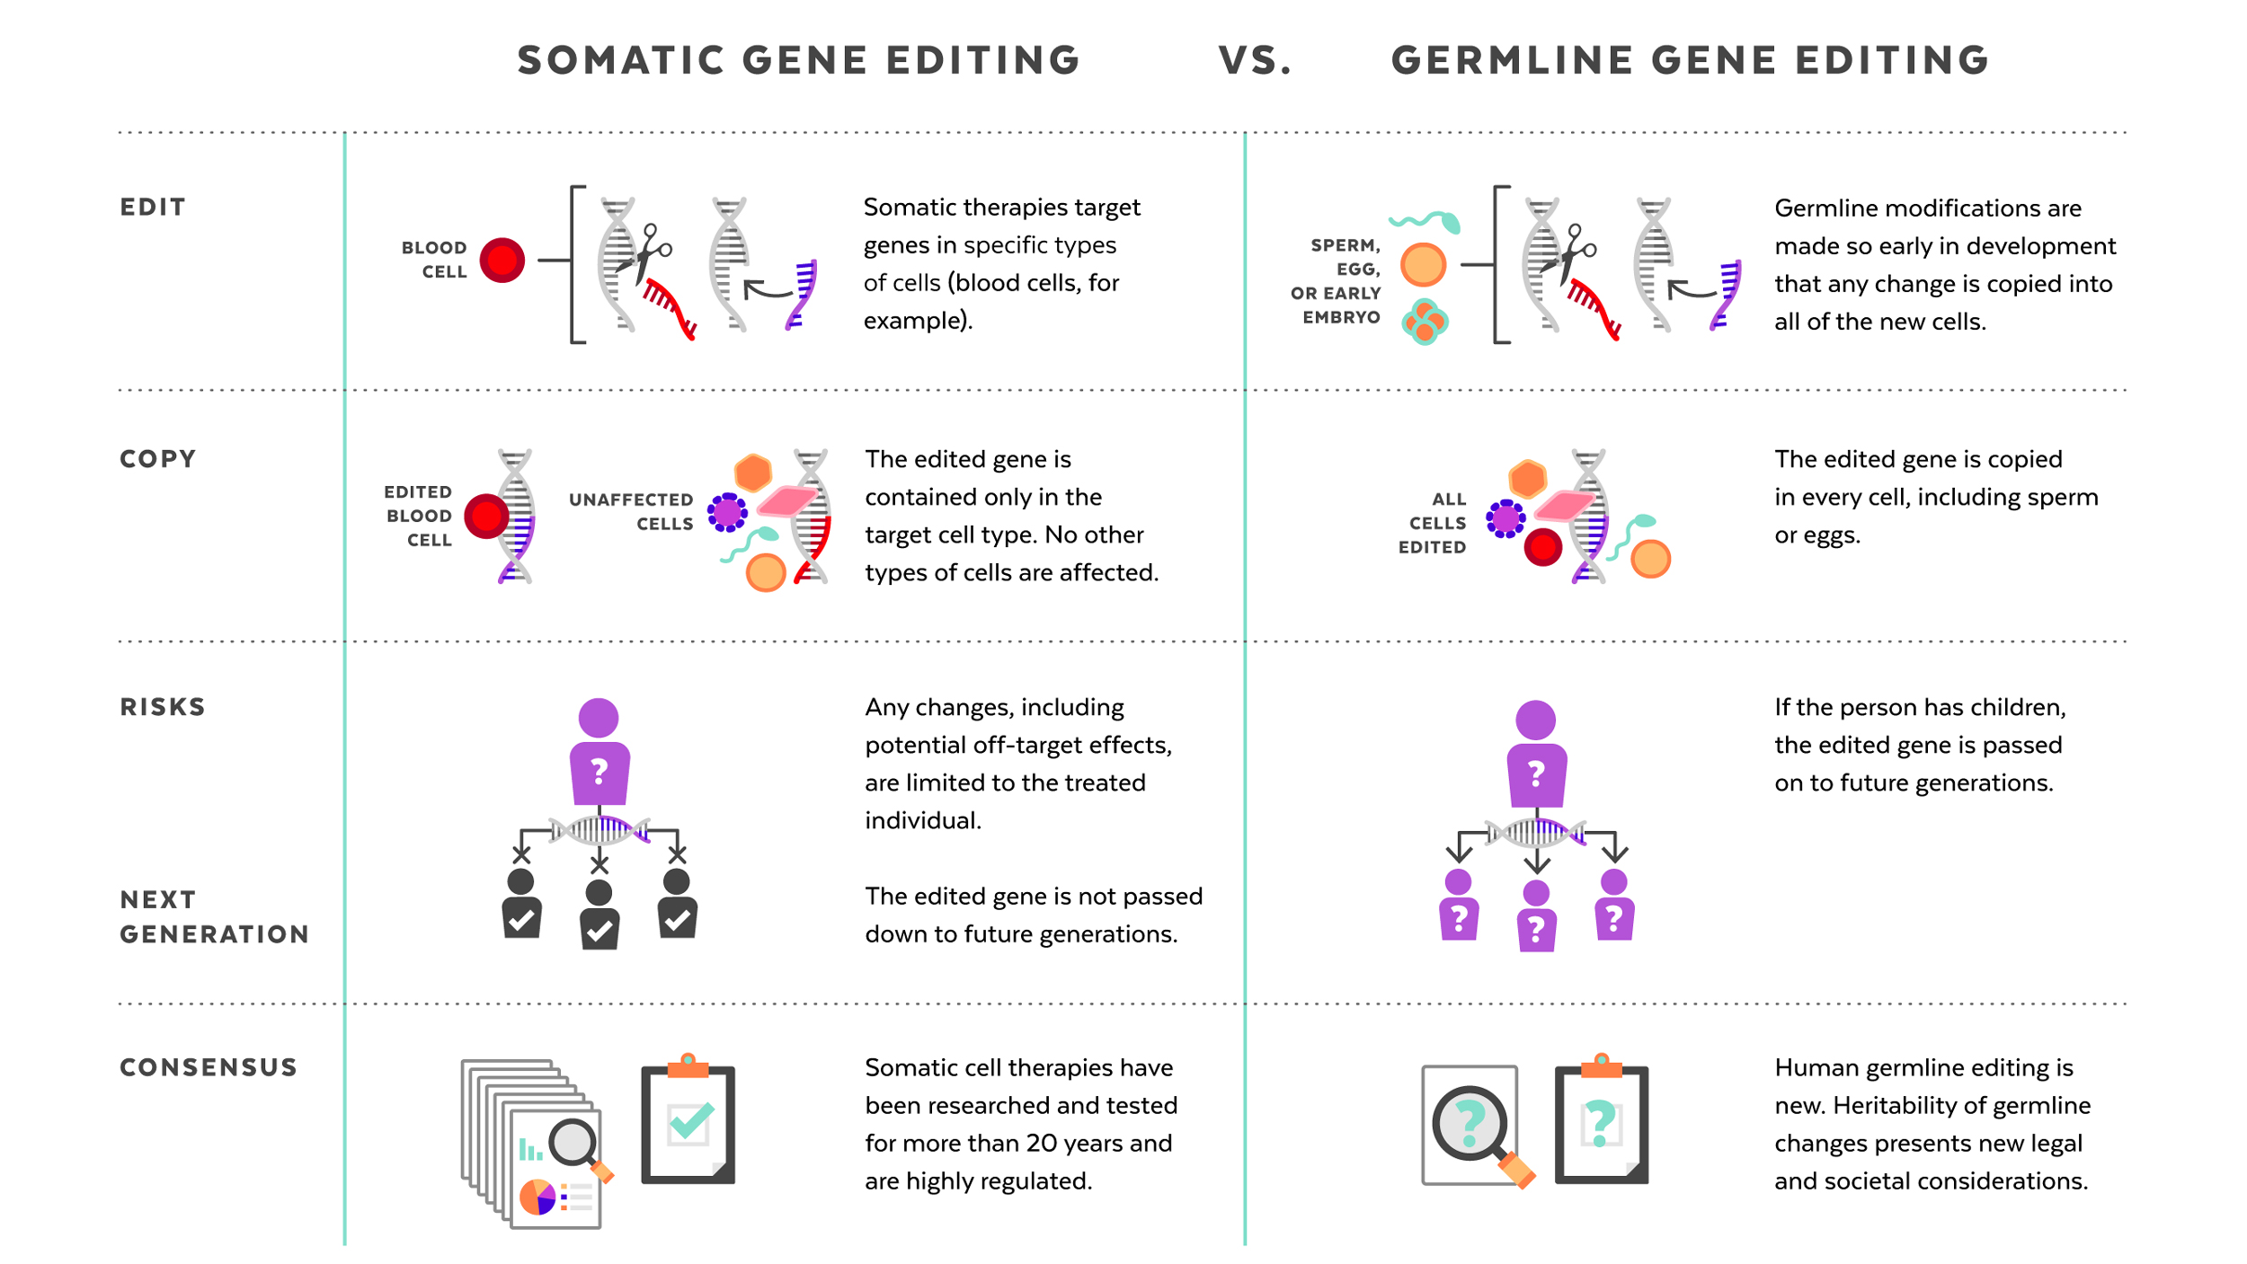

Slide 8
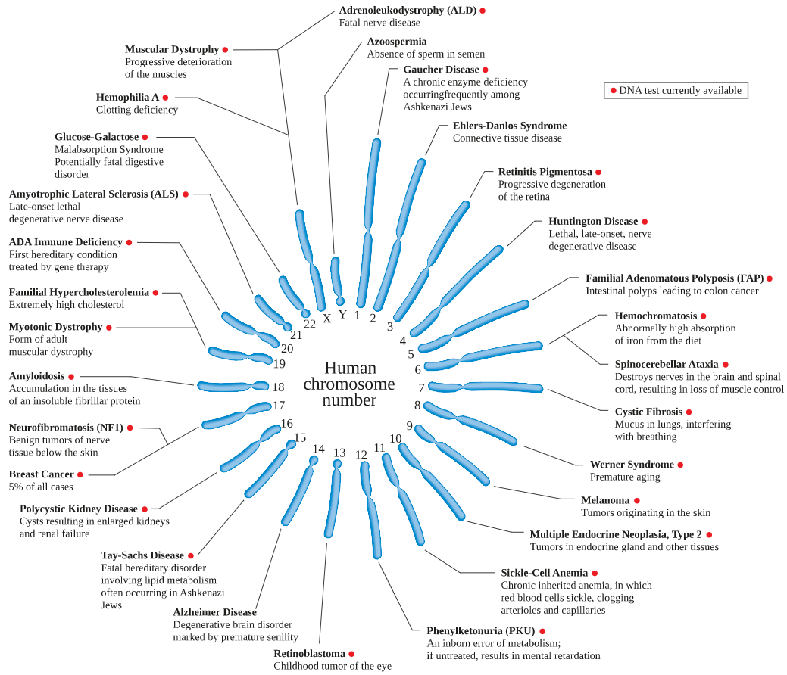
Monogenic diseases:
Polygenic diseases:
Human Genome Mutations Database lists more than 250,000 disease-causing mutations
Psychiatric disorders
Schizophrenia
Bipolar disorder
Cancers
Cardiovascular disease
Coronary artery disease
Cerebral stroke
Type 2 diabetes
Dementia, Alzheimer's disease
Body mass index characteristics
Crohn’s disease, obesity
Chronic migraine
Asthma
Arthritis (osteo, rheumatoid)

Slide 9
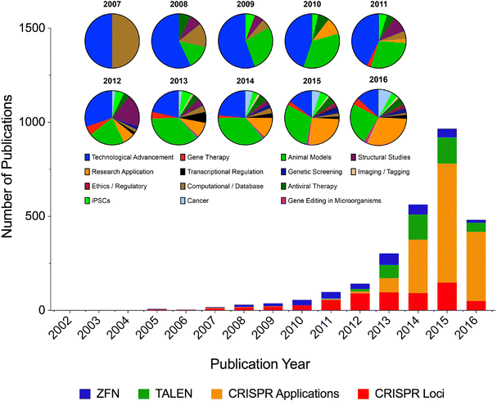
Publication Trends in Genome Editing

Slide 11
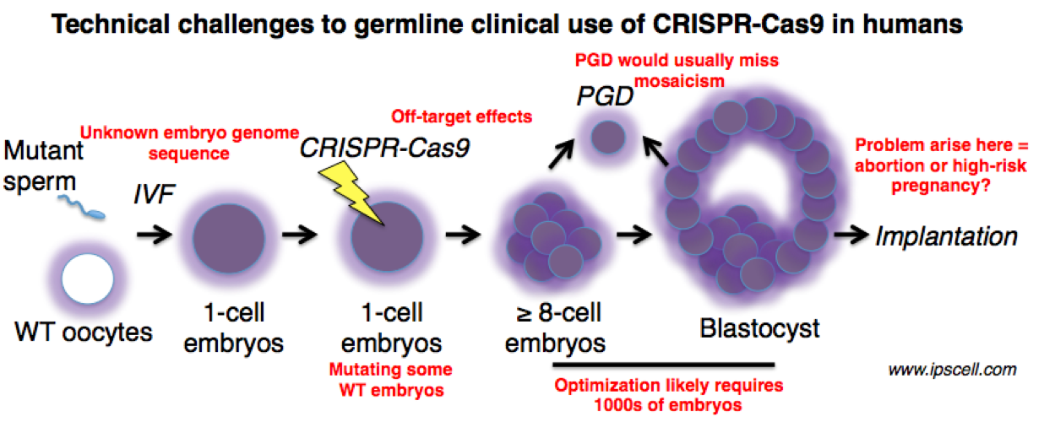

Slide 12
Possible Negative Outcomes When CRISPR is Applied
Off-target mutations: Unintended genes are subsequently modified, without ability to predict these occurrences
Mosaic Embryos: Embryos that contain two or more genetically different cells

Slide 13
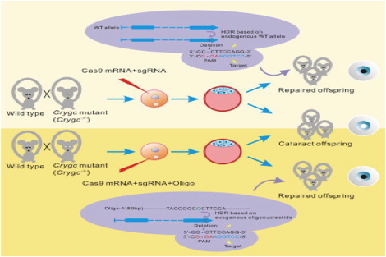
Current Research on Mice Shows Promise

Slide 14
How can safety issues be addressed?
Experimentation
How can experimentation coexist with ethics?
Tripronuclear Zygotes

Slide 15
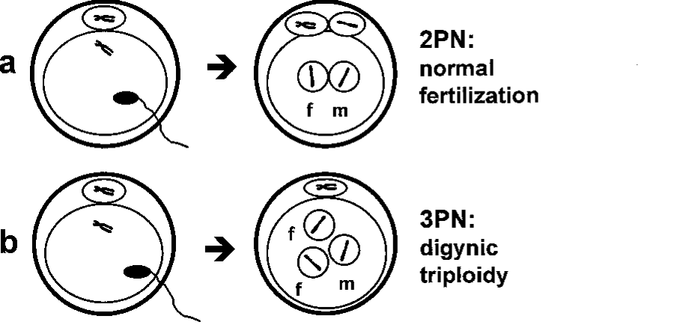
What Are Tripronuclear Zygotes?
Embryos created for in vitro fertilization
Contain multiple sperm nuclei (normal embryos contain only one)
Do not develop once implanted and are discarded by clinics

Slide 16
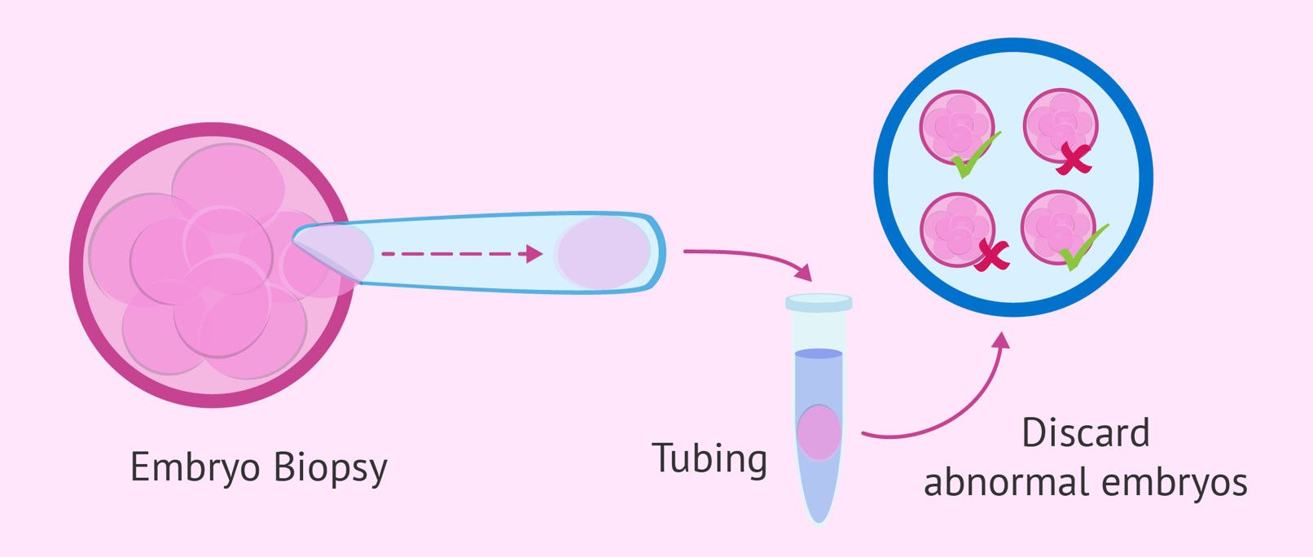
Current Legal Embryo Manipulation Processes:
Post-Implantation Diagnosis
Frequently used in fertilization clinics
Involves removing 2 to 8 cells from specimen which can be detrimental for the survival of an embryo
Embryos are subsequently “selected” while excess embryos are discarded

Slide 17
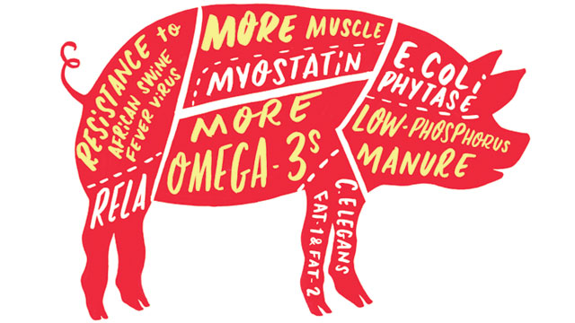
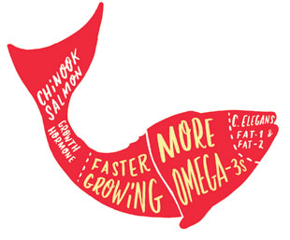
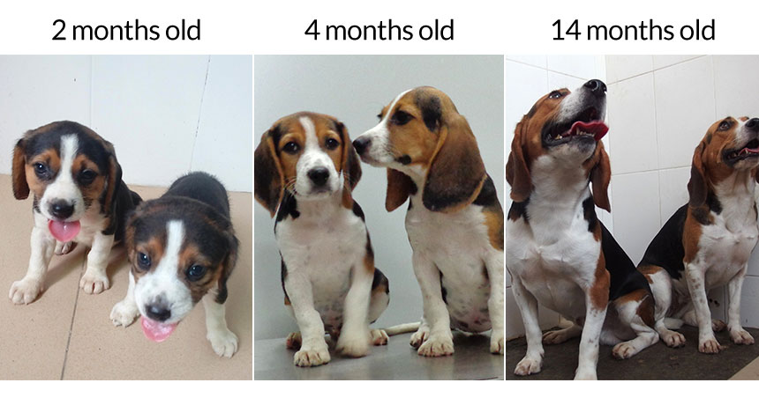
When there are no boundaries
Biology becomes relative
Edited to have more muscles

Slide 18
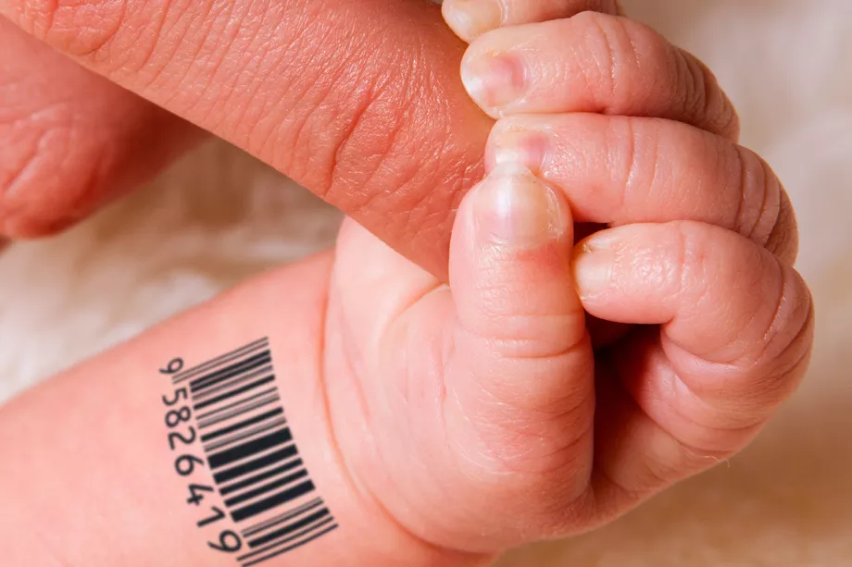
MakeMeABaby.org
5% Discount for twins
For orders 10 or more please contact directly to the main office
*Armed forces require permission from their government before ordering
Designed just for you
A nerd and an athlete?
Engineered to Perfection
Order Now!
Traits of your choice
*Order quantity are limited to 2 per customer, can be returned within 5 years of delivery
Some countries may require adoption before delivery.
Delivery in just 12 months
If NOT regulated
Honey, I think we are ready to make that order

Slide 19
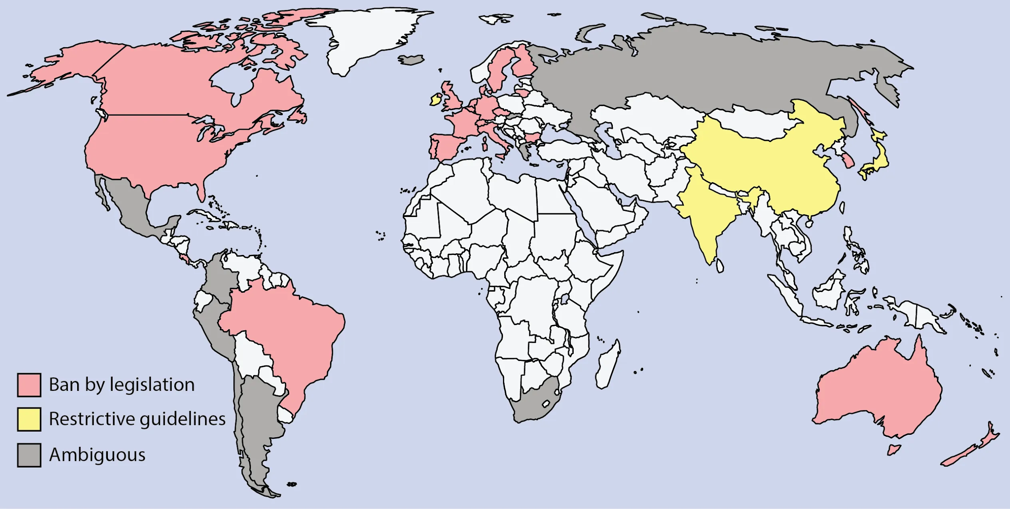
Shipping free
here
MakeMeABaby.org
*Shipped after you adopt
No can do
No restrictions apply on shipping

Slide 20
Questions?

